Slide 1
Name: G.Jeevanraj college .code: 6202 register no :620221104010

Slide 2
Abstract
The software achieved is capable of improving the customer hand and relationship management in ITC operations.
Stru. In addition, PHP Hypertext Preprocessor (PHP) language was used for the front-end of the software while the back end was designed using MySQl.
Strctured Systems Analysis and Design Methodology (SSADM) was adopted. The software achieved is capable of improving the customer hand and relationship management in ITC operations.

Slide 3
Problem statement
The System that is being used by the staff at the counter currently is an internal system and justused to sell the bus ticket at the counter.
Customer has to go to the counter to buy bus ticket orask for bus schedule. Furthermore, customers need to pay cash when they buy the bus ticket andsometimes needs to queue up long time to get the bus ticket.
Besides that, customer also notallowed to buy bus ticket through telephone and the bus company’s telephone has been always- busy line.

Slide 4
Project overview
A bus reservation project involves creating a system for passengers to book bus tickets online.
The project typically includes features such as user registration, ticket booking, seat selection, payment processing, ticket cancellation, and viewing bus schedules.
It may also involve administrative features like managing bus routes, buses, and user accounts.

Slide 5
Technology view
Backend development can be done using languages like Java, Python, Node.js, or PHP. Frontend development can be handled with HTML, CSS, and JavaScript frameworks like React, Angular, or Vue.js.
Frameworks such as Spring Boot (Java), Django (Python), Express.js (Node.js), or Laravel (PHP) can be used to speed up backend development and provide structure to the project.
SQL databases like MySQL, PostgreSQL, or SQLite are commonly used for storing user data, booking information, and bus schedules. NoSQL databases like MongoDB can also be considered for certain use cases.

Slide 6
Modeling
Identify the different user roles involved, such as passengers, administrators, and possibly bus operators.
Define the functionalities and interactions each user role can perform within the system, such as browsing bus schedules, making reservations, managing bookings, and updating bus routes.
Determine the data entities and attributes needed to support the system’s functionalities. This includes entities like users, buses, routes, bookings, payments, etc.

Slide 7
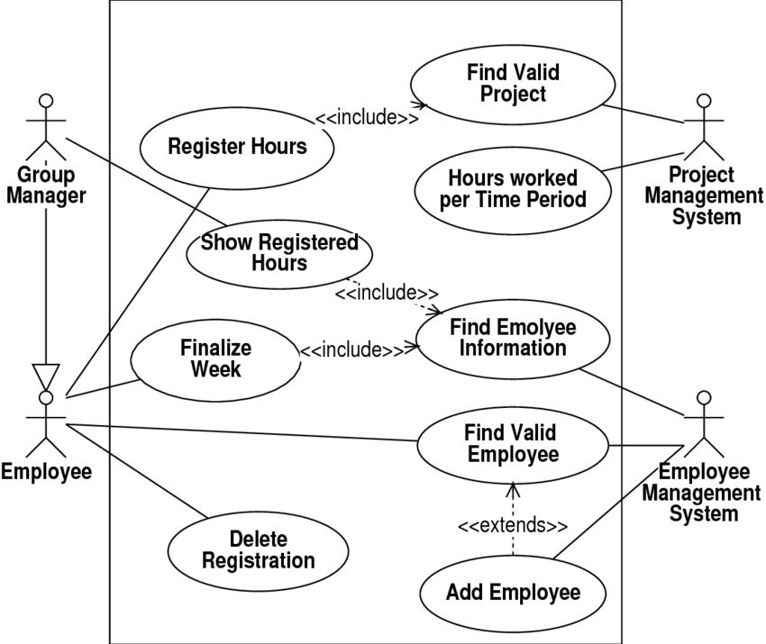

Slide 8
Result
Attributes may include user ID, username, email, password, contact information, and role (e.g., passenger, admin).
A user can make multiple bookings, but each booking is associated with only one user.
Design the tables based on the identified entities and their attributes. Use primary keys, foreign keys, and appropriate data types

Slide 9
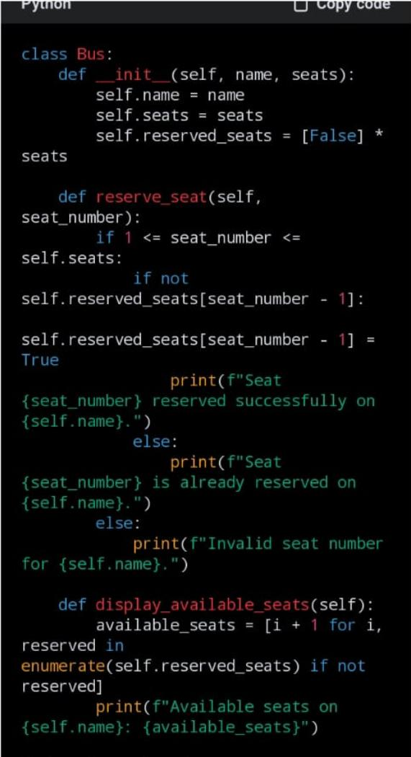
Screen shot

Slide 10
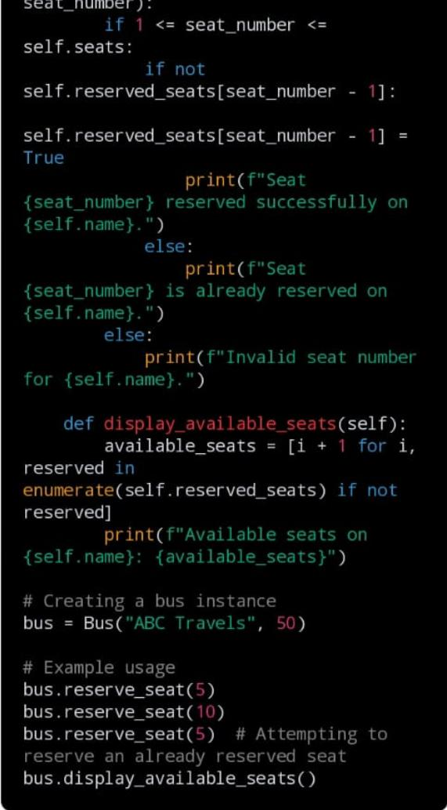
.

Slide 11
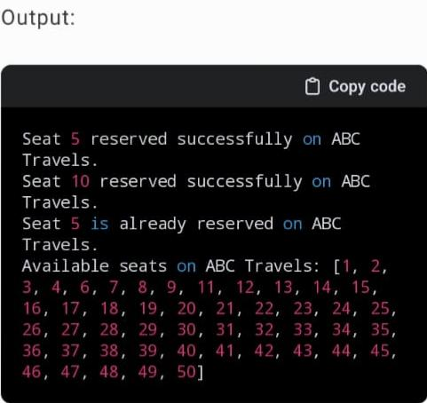
.

Slide 12
Future enhancement
Implement a mobile ticketing system that allows passengers to book and manage their tickets directly from their smartphones. This could include QR code scanning for boarding and real-time updates on seat availability.
Introduce dynamic pricing based on factors such as demand, time of booking, and seat availability. This could optimize revenue for the bus company and offer discounts during off-peak timUtilize
passenger data to provide personalized recommendations for routes, schedules, and amenities based on past booking history and preferences.es to incentivize bookings.

Slide 13
Conclusion
Implement a mobile ticketing system that allows passengers to book and manage their tickets directly from their smartphones. This could include QR code scanning for boarding and real-time updates on seat availability.
Introduce dynamic pricing based on factors such as demand, time of booking, and seat availability. This could optimize revenue for the bus company and offer discounts during off-peak times to incentivize bookings.
Passenger data to provide personalized recommendations for routes, schedules, and amenities based on past booking history and preferences.

Slide 14
Thank you

